Slide 1
FRY9C Reports, Banking, and Crashes:
Can 2008 Predict 2020?
By Jackson Lipfert and João Franco
Notes:
Hello everyone, today João and I will present our project, titled FRY9C Reports, Banking, and Crashes, can 2008 predict 2020?

Slide 2
Outline
Questions: Do Balance Sheets Hold The Secret?
Introduction: What’s A Y9C?
Methods: Finding the Signal
Results: Describing 2008 and 2020
Results: Predicting Bank Results
Discussion: Limitations and Next Steps
Notes:
First, we’ll explain the questions that guided our project, then give a brief introduction to the data source we used to answer them. In our methods section we’ll explain the challenges the data presented to us and how we managed to wrangle it into something useable. Next, we’ll show our results in two sections. First, a descriptive account of both the 2008 crash and the 2020 pandemic, were we even able to find the crash in the balance sheets. Then, we’ll show the results of our predictive analysis, did the Y9C data allow us to predict bank performance. Finally, we’ll present our conclusions, the limitations of our work, and next steps to explore.

Slide 3
Questions
Do Y9C reports show the effects of the 2008 and 2020 crashes?
Can we predict post 2008 crash outcomes using the Y9C?
If so, how well will our model do for the 2020 crash?
3. Same approach instead of model
Notes:
So, what are we trying to do here? First, we wanted to know if indicators of the 2008 crash were present in the quarterly Y9C reports that holding companies file with the federal reserve. In other words, can your bank’s 2007 balance sheet tell us know well your bank will do in 2008 and 2009? If the answer to the last question is yes, will the predictive model hold for the COVID pandemic in 2020?

Slide 4
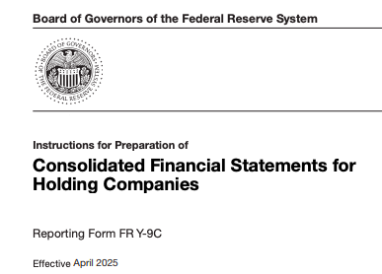
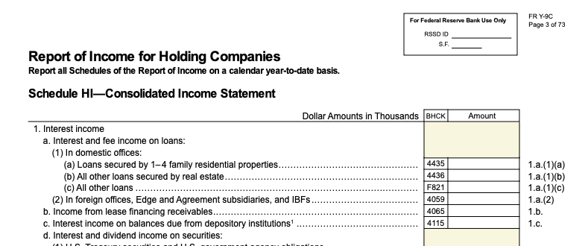
Introduction: What’s A Y9C?
Notes:
Now, before we answer those questions, we have to a brief, hopefully, overview of the Y9C report. Fundamentally, the Y9C report is two things, an income statement and a balance sheet. The income statement is cumulative over the financial year, earnings will go up and up until the the end of Q4 when everything resets. The balance sheet reflects the assets and liabilities held by the filing financial institution and isn’t cumulative, it’s a quarterly snapshot into the company. This is a massive oversimplification but it will have to do. Now, João is going to explain the choices we made while preparing the data.

Slide 5
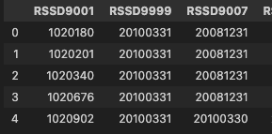



Methods: Finding the Signal
Original_Code | Feature
RSSD9001 | ID
BHCK4107 | REVENUE
BHCK4079
BHCK3521
FRY9C vs. FRYLP vs. FRYSP
Notes:
Initially we started with about 60 files with ~2000 columns. All the columns were represented by 4 letter 4 digit codes as you can see. First, we used the Federal Reserve’s data dictionary to give the columns readable names. We then decided to drop columns from the YLP and YSP part of the report and focus only on the Y9C columns. The LP and SP refer to large and small parent companies respectively, each with their own requirements and filing schedule. Some companies will file just a 9C, others a 9C and LP, sometimes with the same values and sometimes with others. Some companies will file LP or SP one year but not another. For all these reasons we decided to use the more consistent 9C report only. After all that, and a whole lot of googling, we decided on the columns we would use.

Slide 6
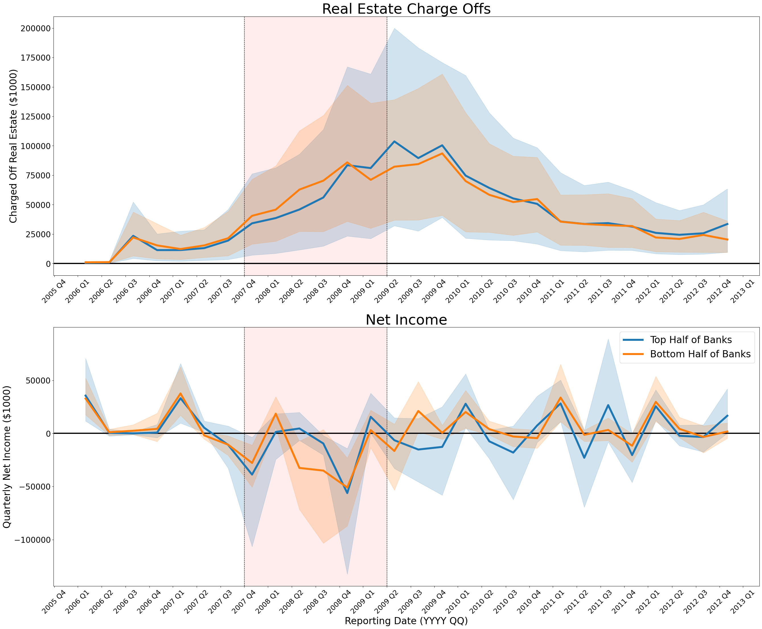
Results: Describing 2008
Duration of financial crisis (NBER)
Notes:
Now, let’s get into the results. First, the light red band on the graph marks the official start and end of the great recession. The top graph shows real estate chargeoffs, These are loans that the bank are writing off as loses. They aren’t necessarily in default but its the next closest thing. The bottom graph is net income, or profit. We broke up the banks by top 50% and bottom 50% based on total assets to see if there was a major difference between them. As you can see profit took a nosedive during the gret recession but chargeoffs peaked even later and didn’t return to baseline until 2012. It’s also worth noting that because our data is quarterly, it’s likely masking the true extent of losses due to government bailouts done to prop up failing banks. Now, let’s take a look at 2020.

Slide 7
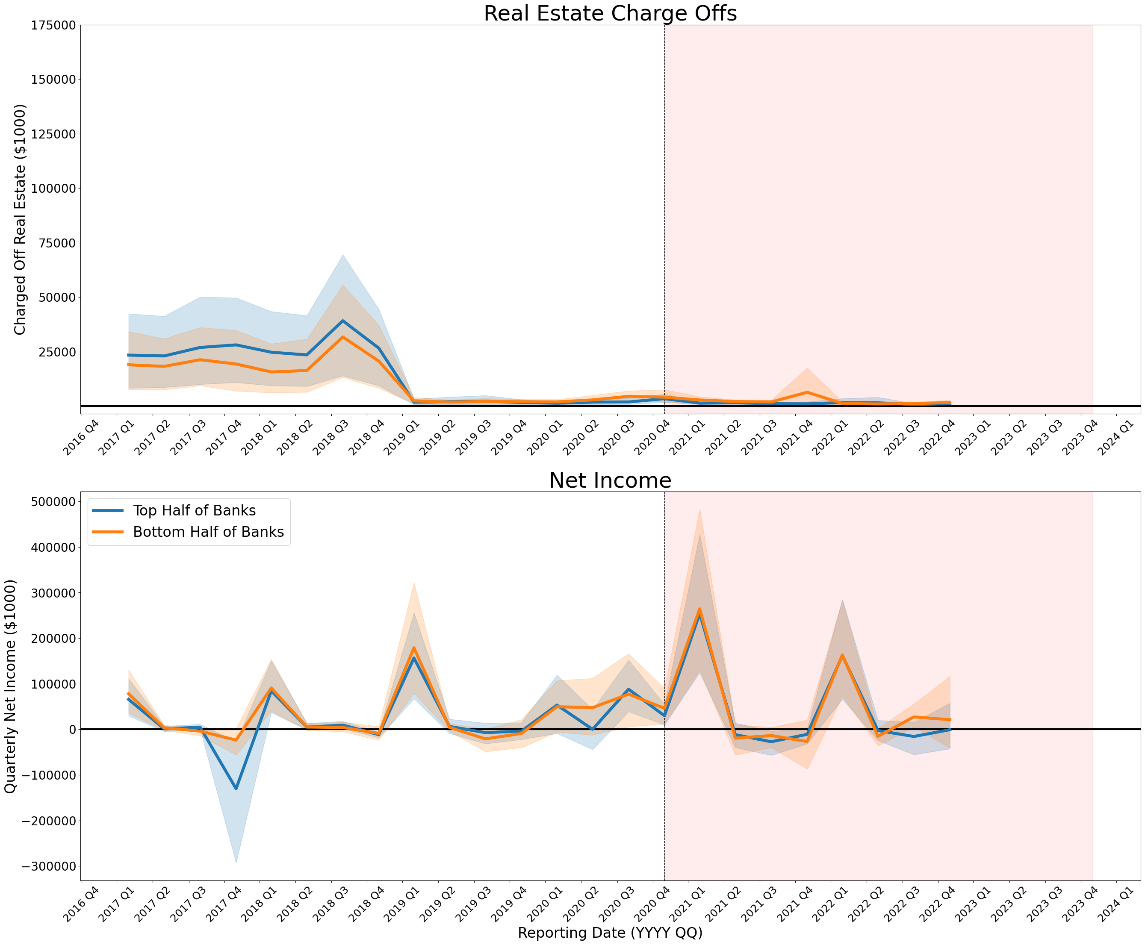
Results: Describing 2020
Duration of COVID pandemic (CDC)
Notes:
I’ve kept the scale the same for real estate chargeoffs so you can see how big the difference is. The scale for net income is different, largely due to how much more profitable banks are in later reports. I think this is due to changes in reporting criteria but that’s a separate story. Put simply, the banks were taking massive losses on real estate loans in 2008 and onward, not so in 2020. Is that enough to ruin our prediction?

Slide 8
Results: Predicting Bank Results
Objective:
Identify FRY9C financial institutions disappearing or in bottom 25% in revenue growth performance
Key features :
General Income statement metrics
Balance sheet metrics
Loans specific metrics
Reported resilience ratios
Case Studies:
Financial crises, 3rd Q 2008
... also, Covid financial turmoil, 3rd Q 2021, bear with me!
Notes:
General Income statement metrics, such as: Total Revenue, Net Income, Earnings before Tax
Balance sheet metrics, such as: Total Assets, Total Equity, Assets per class (cash, securities)
Loans specific metrics, such as: Charged Offs per class (e.g.: to real estate), (Loan) Recoveries per class (e.g.: to farmers), Loans Loss Provisions)
Reported resilience ratios, such as: Tier 1 Capital Ratio

Slide 9
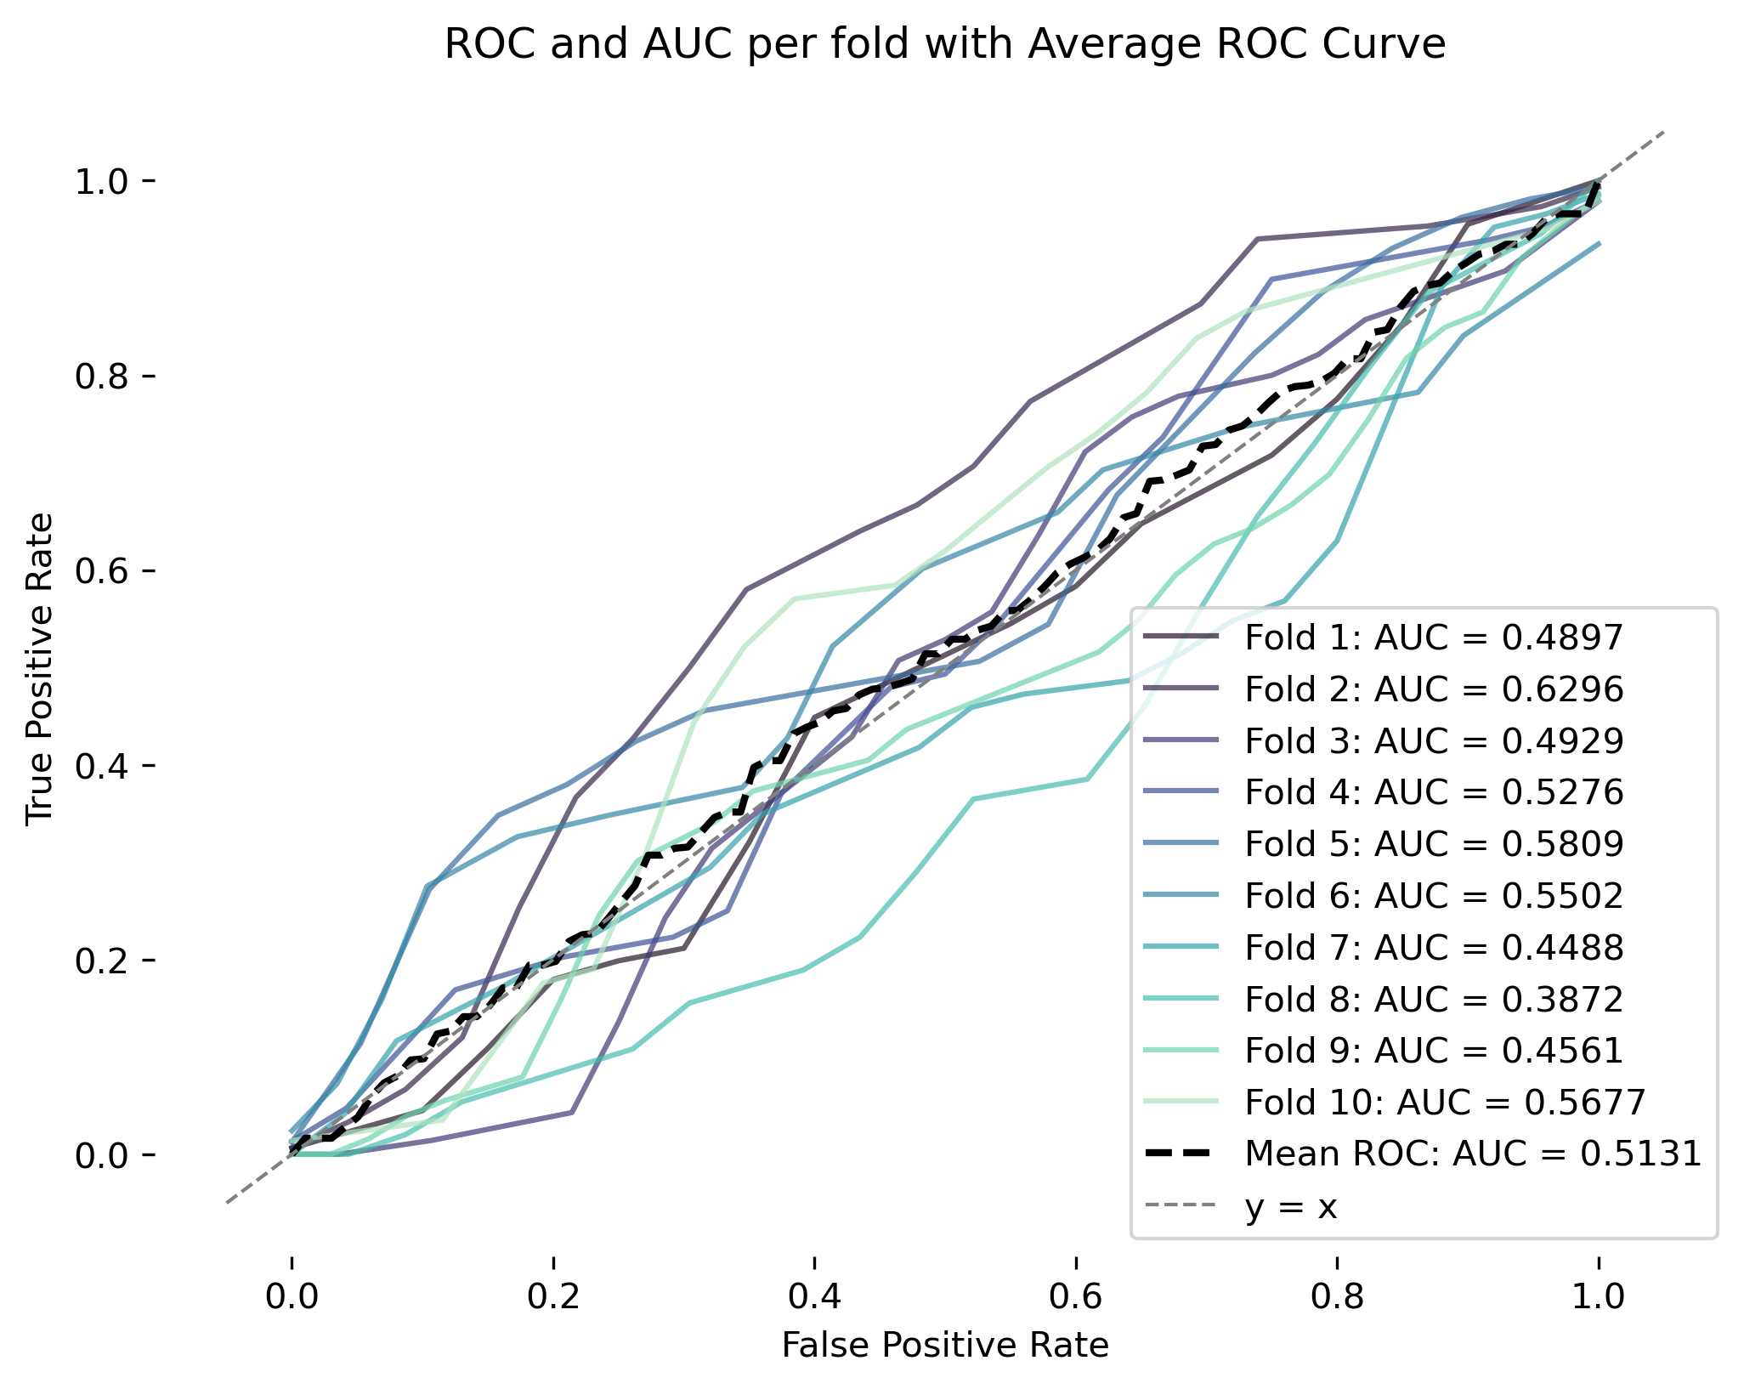
Results: Predicting Bank Results
Trial 1: Financial data from prev. quarter (2nd Q 2008)

Slide 10


Results: Predicting Bank Results
Trial 1: Financial data from prev. quarter
Trial 2: Financial data from prev. quarter + financial growth (2, 4, 6, 8 quarters before “prev. quarter”)
Trial 3: Financial data in 6 quarters before crisis + financial growth (2, 4, 6, 8 quarters before “6 quarters before the crisis ”)
Trial 4: Financial data in 6 quarters before crisis

Slide 11
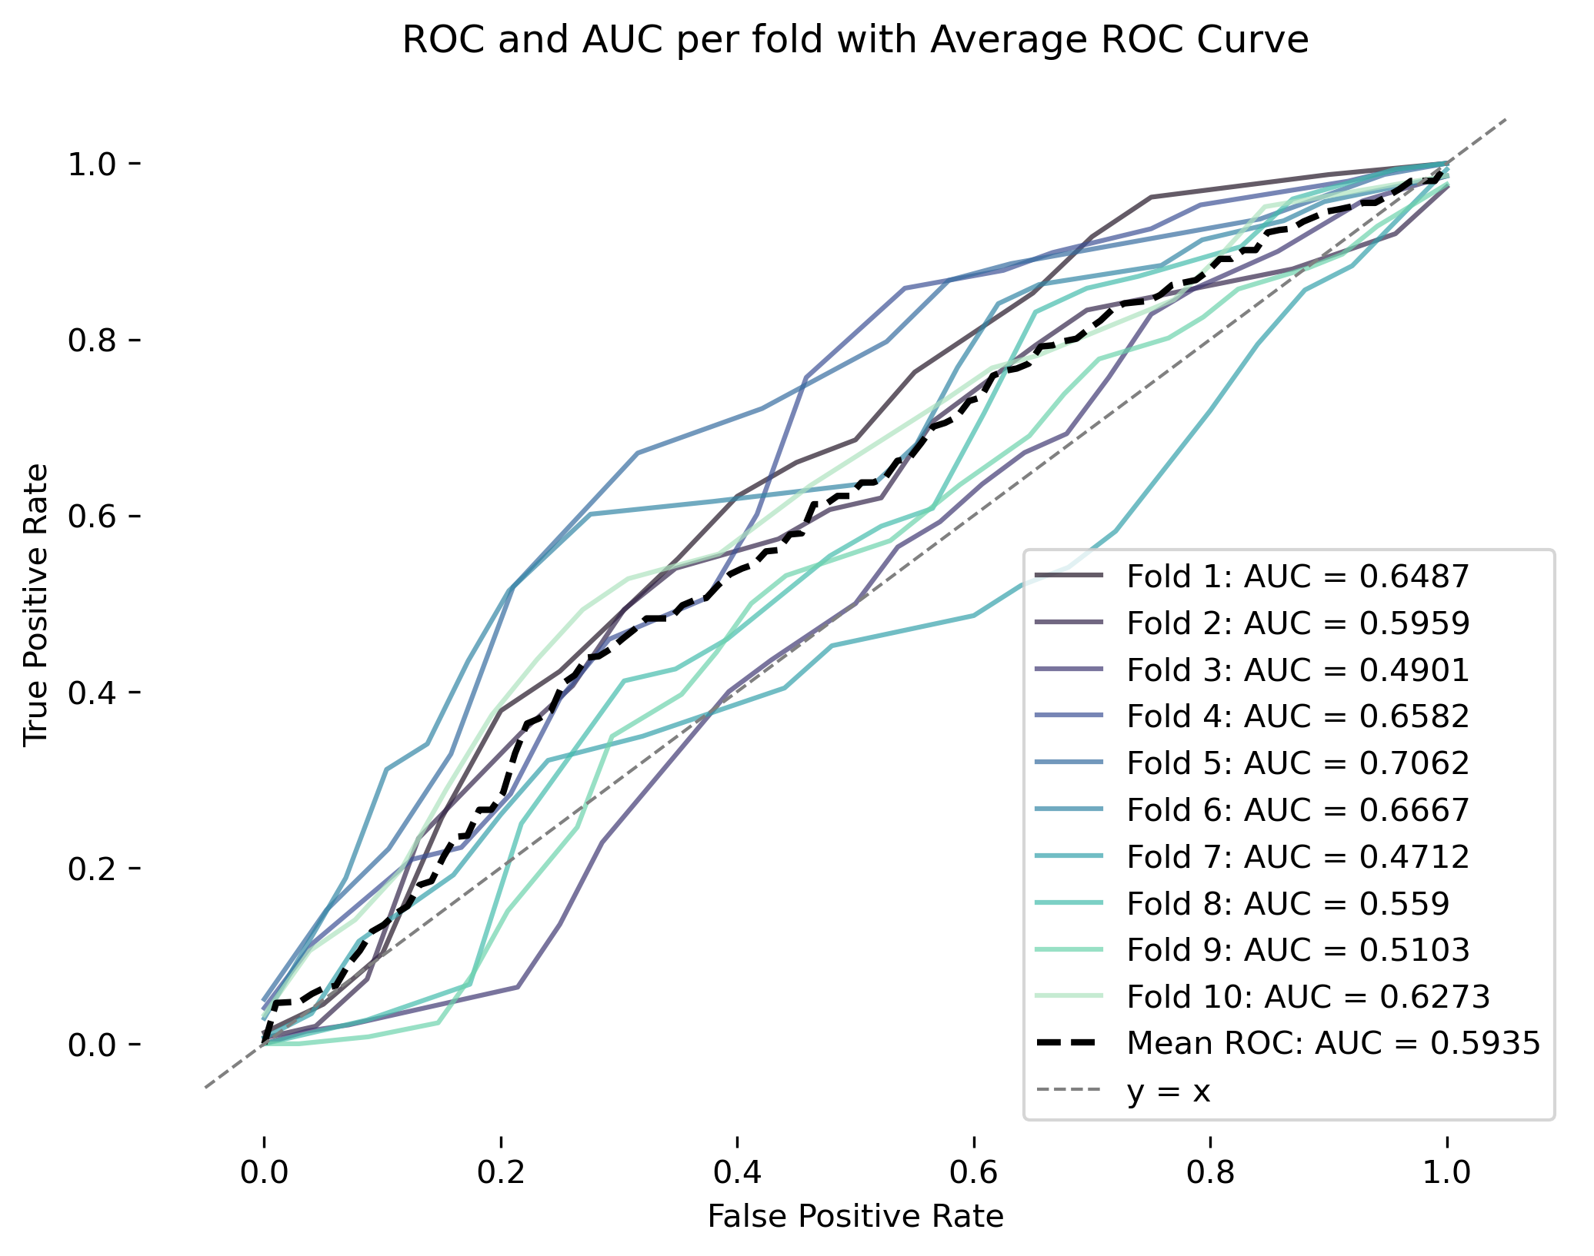
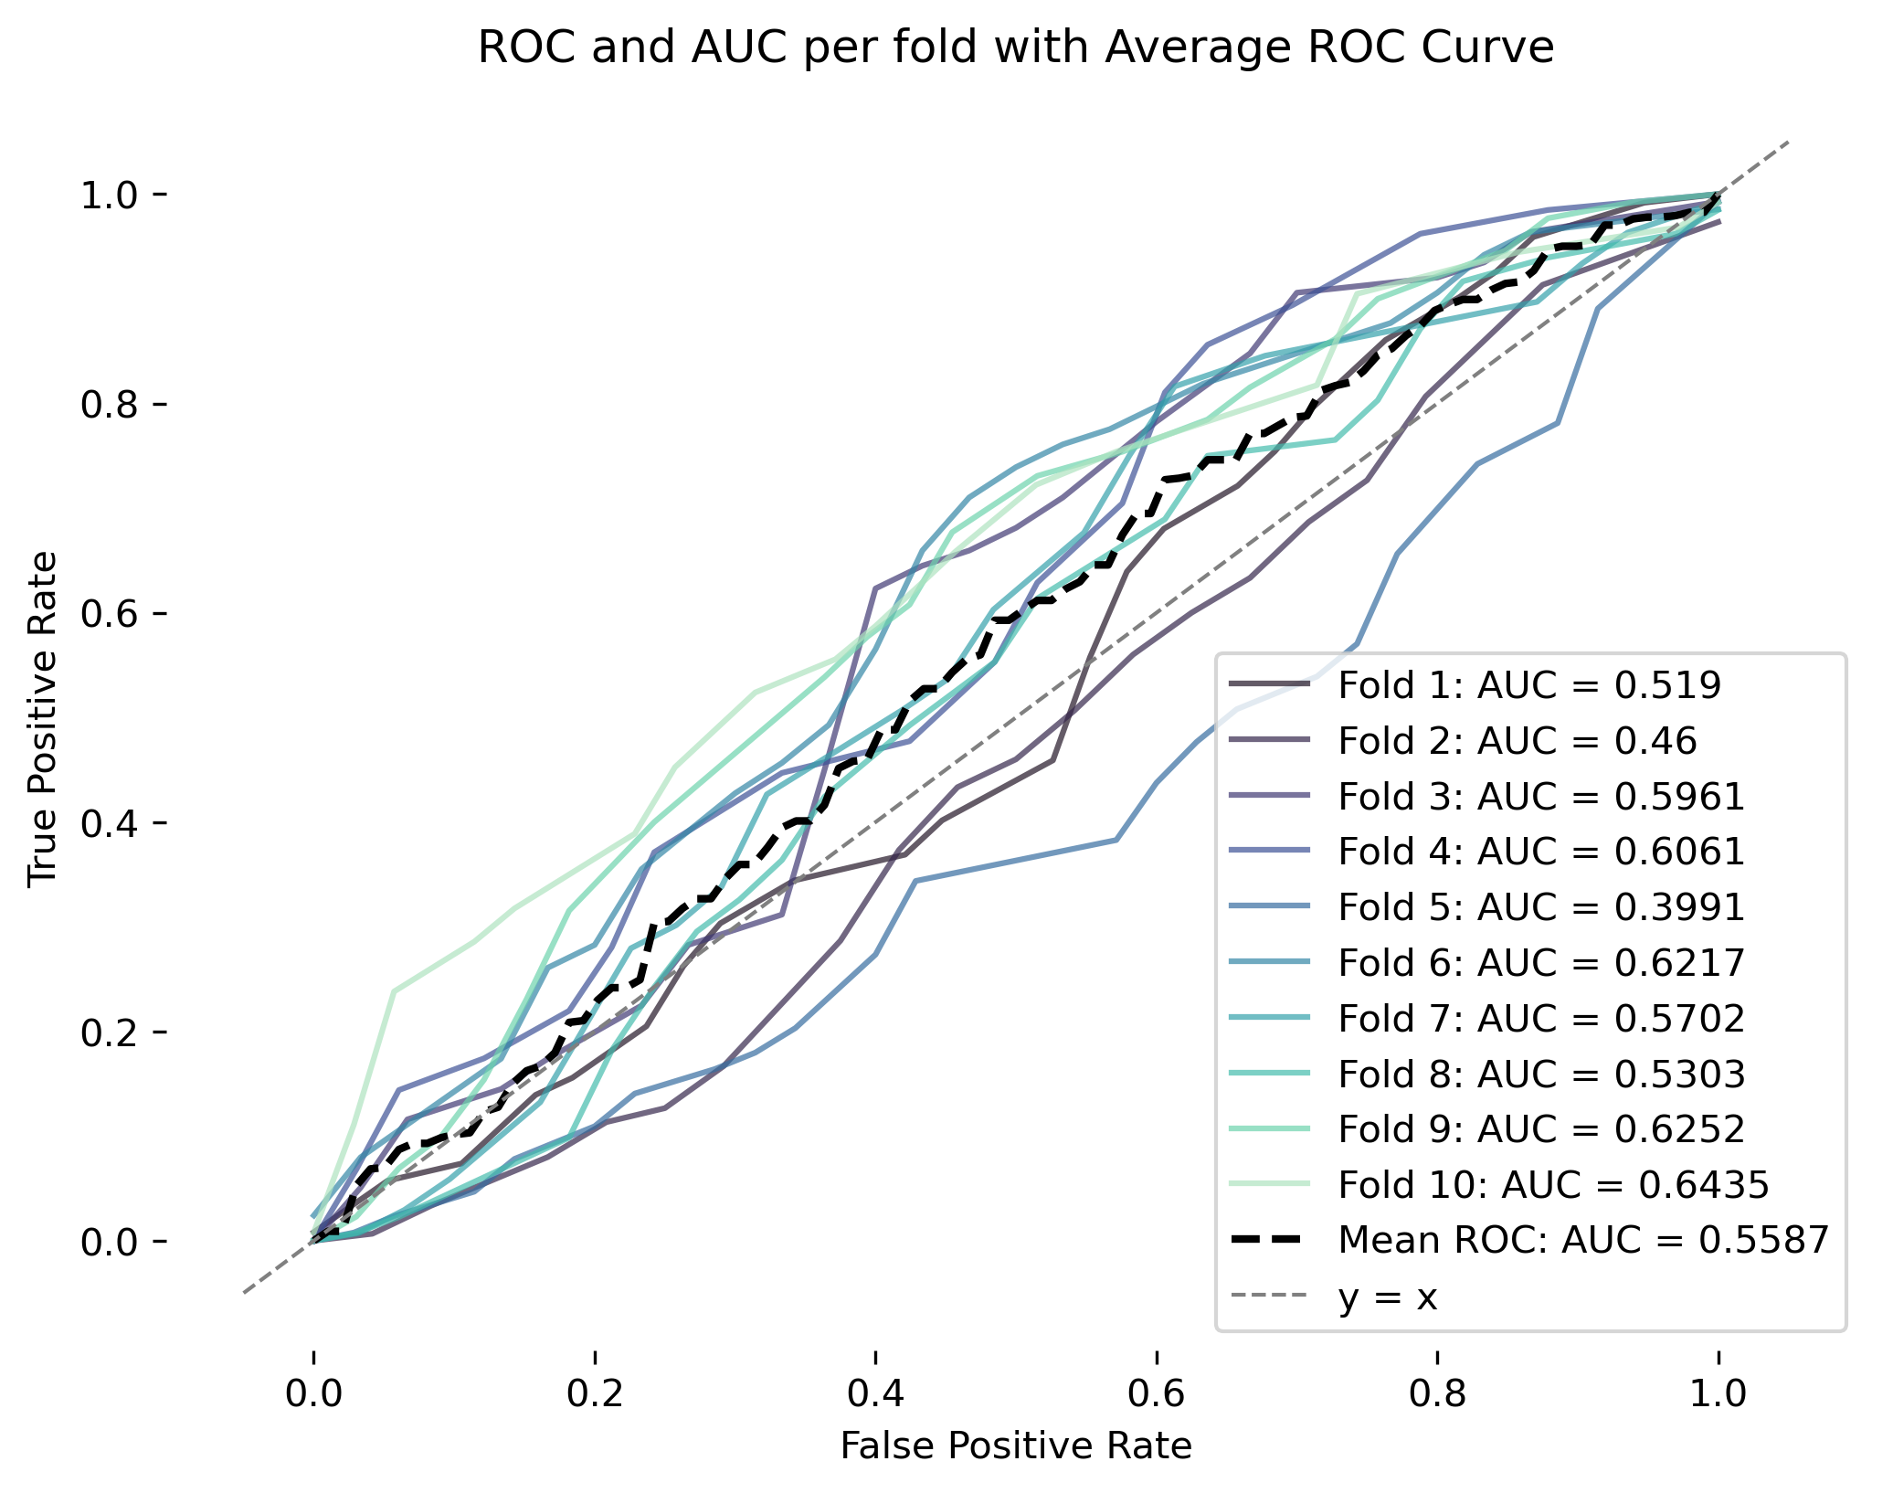
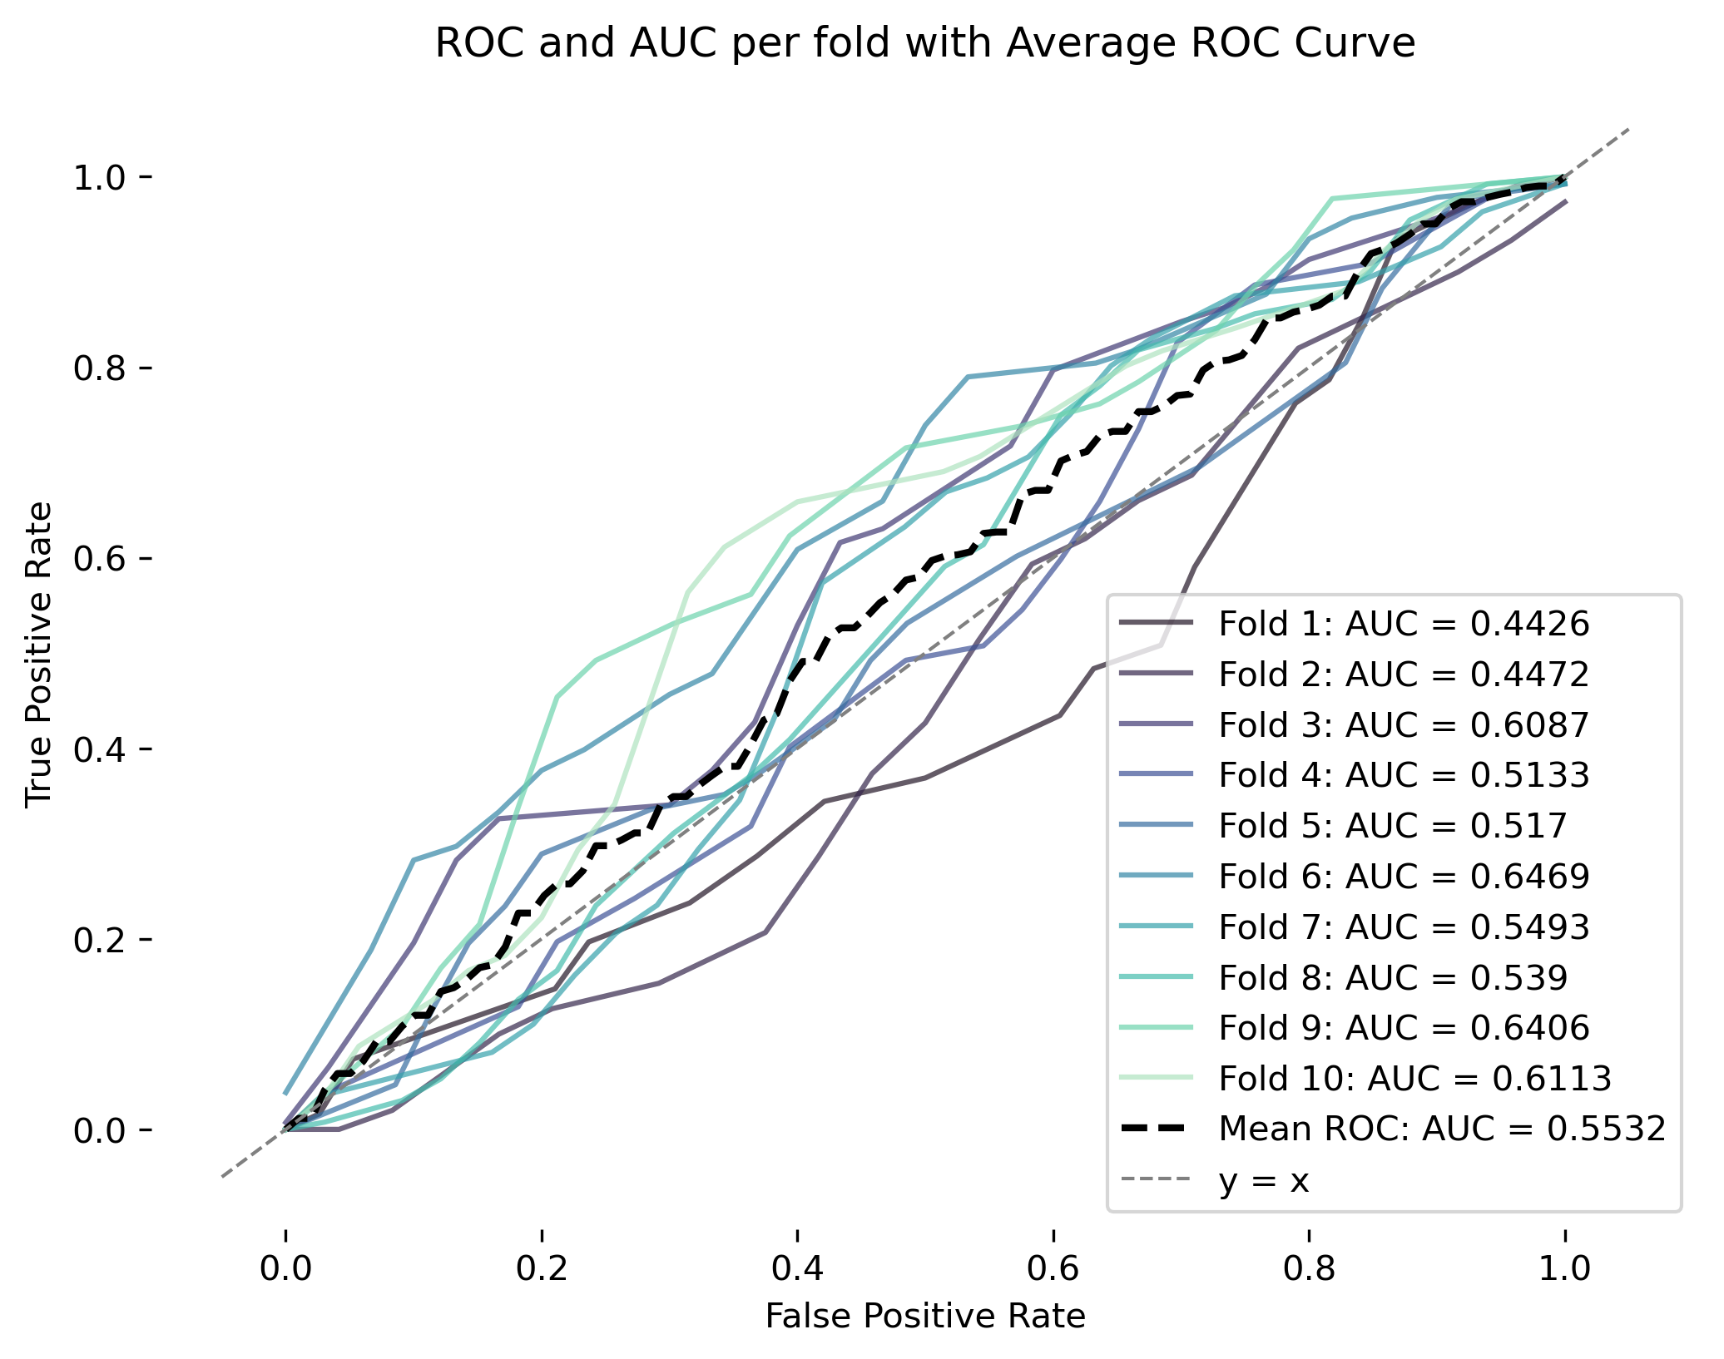
Results: Predicting Bank Results
Trial 2
AUC: 0.5935
Trial 3
AUC: 0.5587
Trial 4
AUC: 0.5532
Notes:
Trial 1: Financial data from prev. quarter
Trial 2: Financial data from prev. quarter + financial growth (2, 4, 6, 8 quarters before “prev. quarter”)
Trial 3: Financial data in 6 quarters before crisis + financial growth (2, 4, 6, 8 quarters before “6 quarters before the crisis ”)
Trial 4: Financial data in 6 quarters before crisis

Slide 12
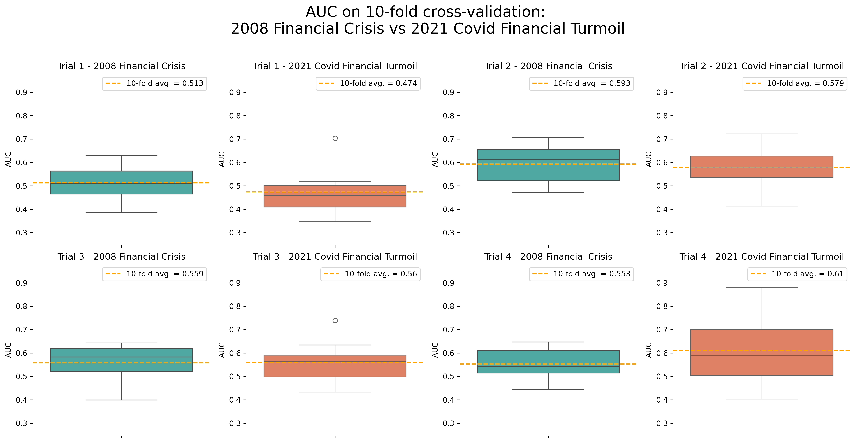
Results: Predicting Bank Results
Financial crises
Covid financial turmoil
Notes:
Trial 1: Financial data from prev. quarter
Trial 2: Financial data from prev. quarter + financial growth (2, 4, 6, 8 quarters before “prev. quarter”)
Trial 3: Financial data in 6 quarters before crisis + financial growth (2, 4, 6, 8 quarters before “6 quarters before the crisis ”)
Trial 4: Financial data in 6 quarters before crisis

Slide 13
Discussion, Limitations, Next Steps
And other banks (ie. not holding banks) or financial information (ie. Basel I, II and III KPIs)?
Heterogenous banks driving inter-folds differences?
Endogenous & exogenous crises require different causal assumptions?

Slide 14
Thank you!

Slide 15
Discussion, Limitations, Next Steps
Intro: Do Balance Sheets Hold The Secret?
Background: What Even Is a Y9C?
Methods: Find

Slide 16
OUTLINE
Open with the big short? Steve Carrell Christian Bale and Ryan Reynolds explained the 2008 financial crash in a whole movie, we have 10 minutes and 2 crashes so how’s that. Key question, can we find the indicators of the 2008 crash in bank balance sheets, can we predict outcomes using it? If so, do they work in 2020?
Give rough overview of banks vs holding companies, tee up the data.
Talk about y9c report itself, multiple reports with changes over time, unreadable column names. Cumulative and non cumulative columns we had to manipulate. Quarterly data and the problems it poses.
Explain why we decided to go with just the y9c report and what limitations it presents. This is part of methods
Used data dictionary, filing guides, João’s knowledge of finance, literature review, and some help from ChatGPT to narrow down our columns to ~100. We then made the cumulative columns quarterly.
Results: done in 2 parts
Show 2008 and 2020 each on their own. Start with 2008, walk through it, then compare it against 2020. Give rough overview of the mechanics of the crash including loan charge offs, loan loss provisions, Explain that the bailouts likely hide some of the losses. Show prediction fails when you only use a single quarter but works when you include the whole data.
Here’s where we get into our question again and our results. If the causes are the same then prediction should hold up right? Show difference in loan charge offs, income, use this to show explanatory. Show that predictions based on balance sheet data don’t work for 2020, the crash likely was caused by some other mysterious force that nobody knows…
Limitations: biggest one is granularity of data. Quarters are long and so much happened in between that we just don’t have access to. Loan information, lives on separate reports that we weren’t able to integrate given our constraints. Changes to the y9c reporting requirements over time make apples to apples comparison more difficult.

Slide 17
Outline
Intro: Do Balance Sheets Hold The Secret?
Background: What Even Is a Y9C?
Methods: Finding Signal in the Noise
Results: Describing 2008 and 2020
Predicting Bank Results
Discussion: Limitations and Next Steps
there is one slide between 4 and 5 and is methods as well. but not sure how to frame it.
also not sure 3. is really methods
also I would erase 6.
Notes:
We don’t have a ton of time so we’ll be moving a bit quick. First, we’ll explain our research questions, then give a brief background on the data source we used to answer them. We’ll explain the challenges the data presented to us and how we managed to wrangle it into something useable. We’ll show our results in two sections, first for the 2008 period and second for the 2020 period. Finally, we’ll present our conclusions, the limitations of our work, and next steps to explore.

Slide 18
Results: Predicting Bank Results
Objective:
Identify FRY9C financial institutions disappearing or in bottom 25% in revenue growth performance
Key features :
General Income statement metrics, such as: Total Revenue, Net Income, Earnings before Tax
Balance sheet metrics, such as: Total Assets, Total Equity, Assets per class (cash, securities)
Loans specific metrics, such as: Charged Offs per class (e.g.: to real estate), (Loan) Recoveries per class (e.g.: to farmers), Loans Loss Provisions)
Reported resilience ratios, such as: Tier 1 Capital Ratio
Notes:
General Income statement metrics, such as: Total Revenue, Net Income, Earnings before Tax
Balance sheet metrics, such as: Total Assets, Total Equity, Assets per class (cash, securities)
Loans specific metrics, such as: Charged Offs per class (e.g.: to real estate), (Loan) Recoveries per class (e.g.: to farmers), Loans Loss Provisions)
Reported resilience ratios, such as: Tier 1 Capital Ratio

Slide 19
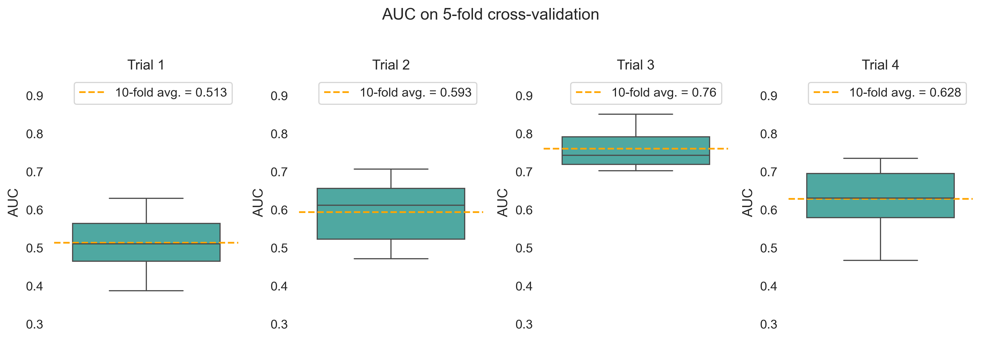
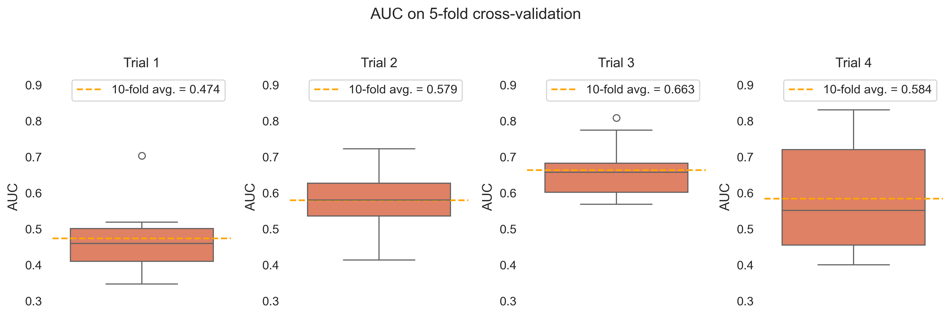
Results: Predicting Bank Results
Financial crises
Covid financial turmoil

Slide 20
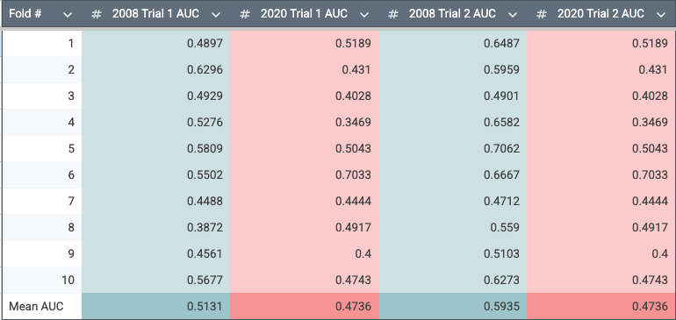
Trial 1 & 2: 2008 vs. 2020

Slide 21
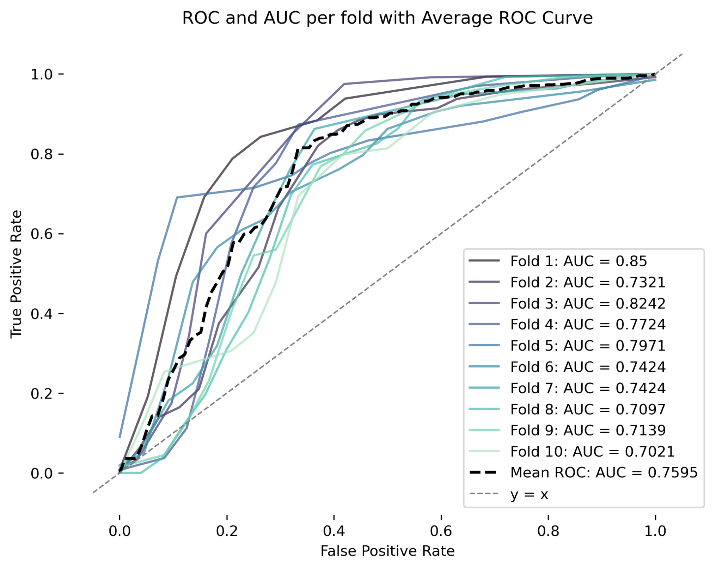
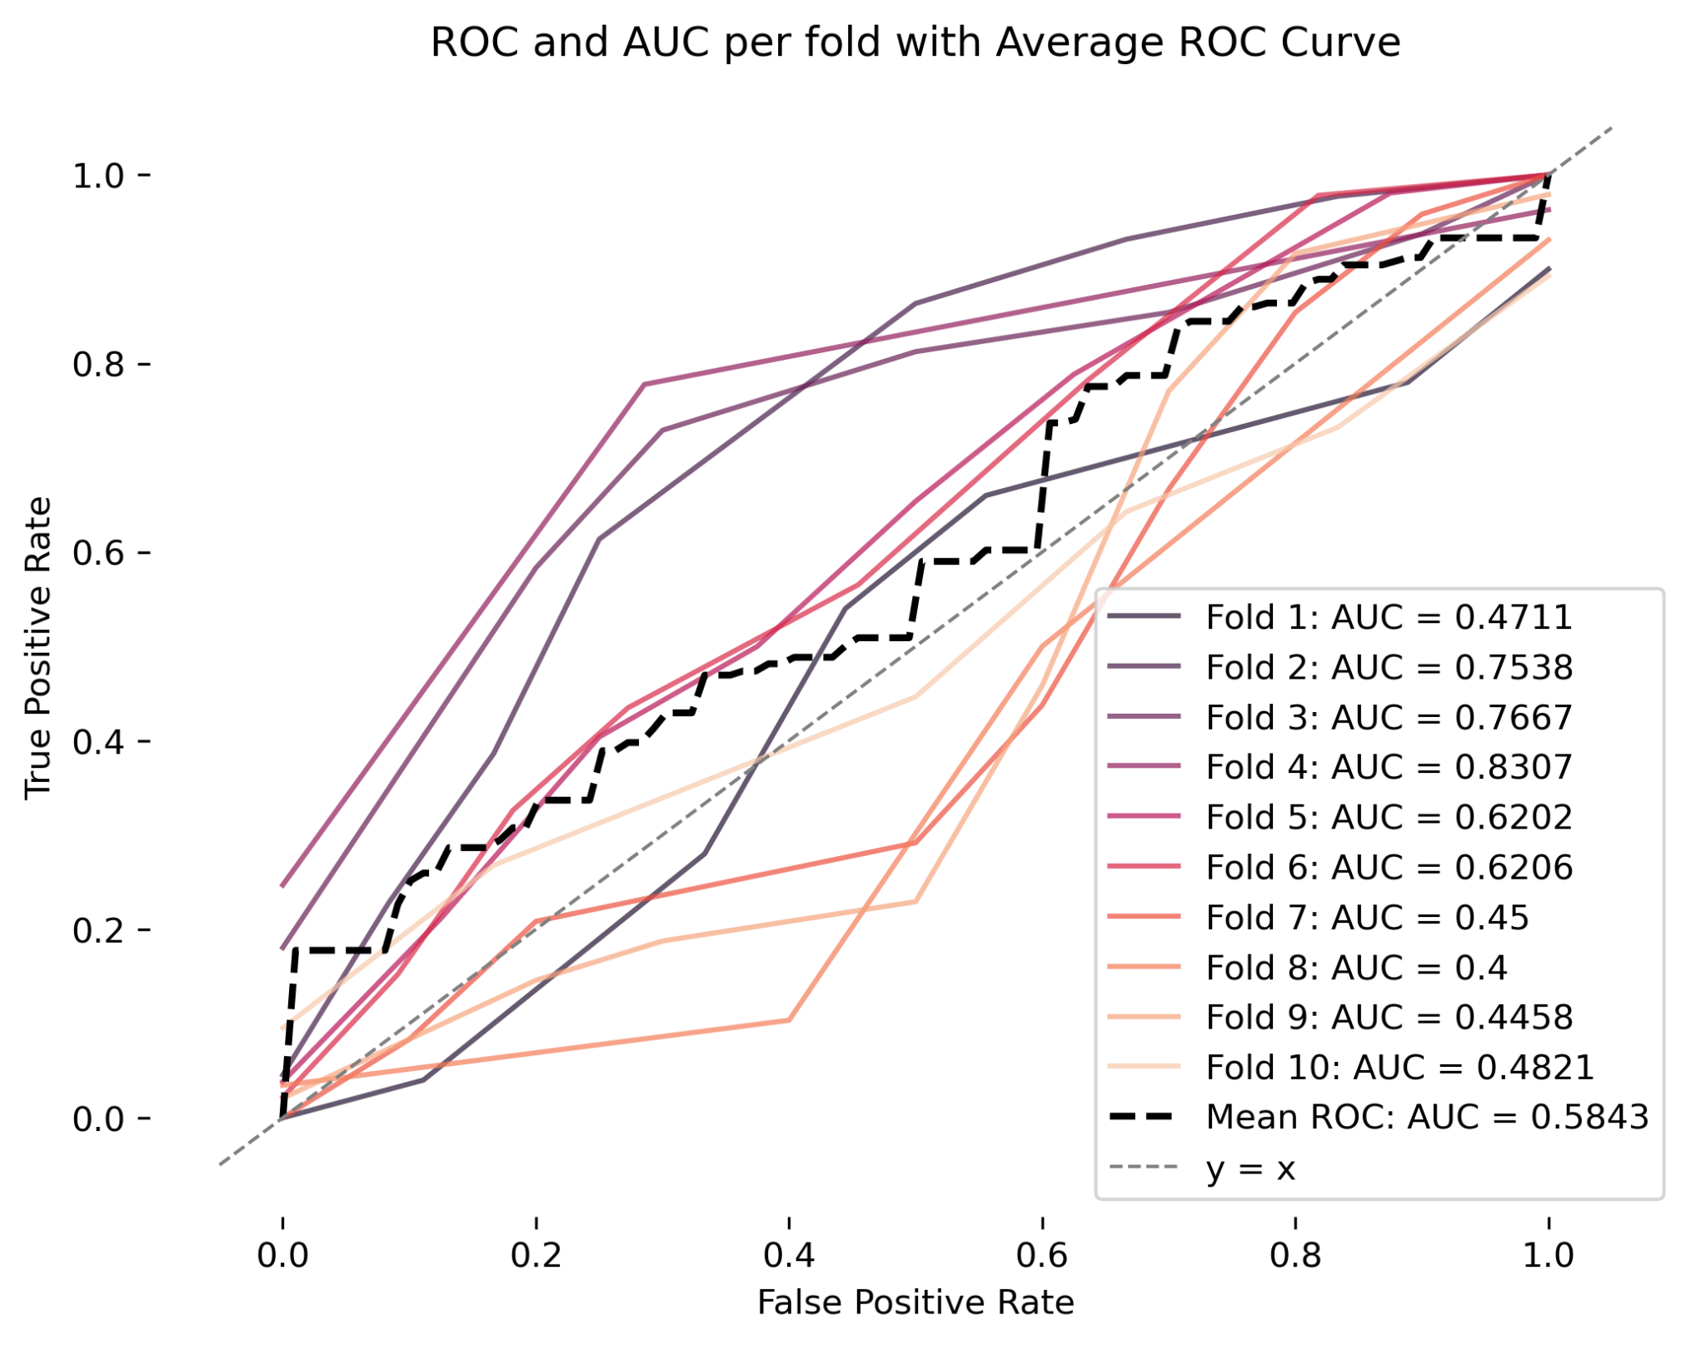
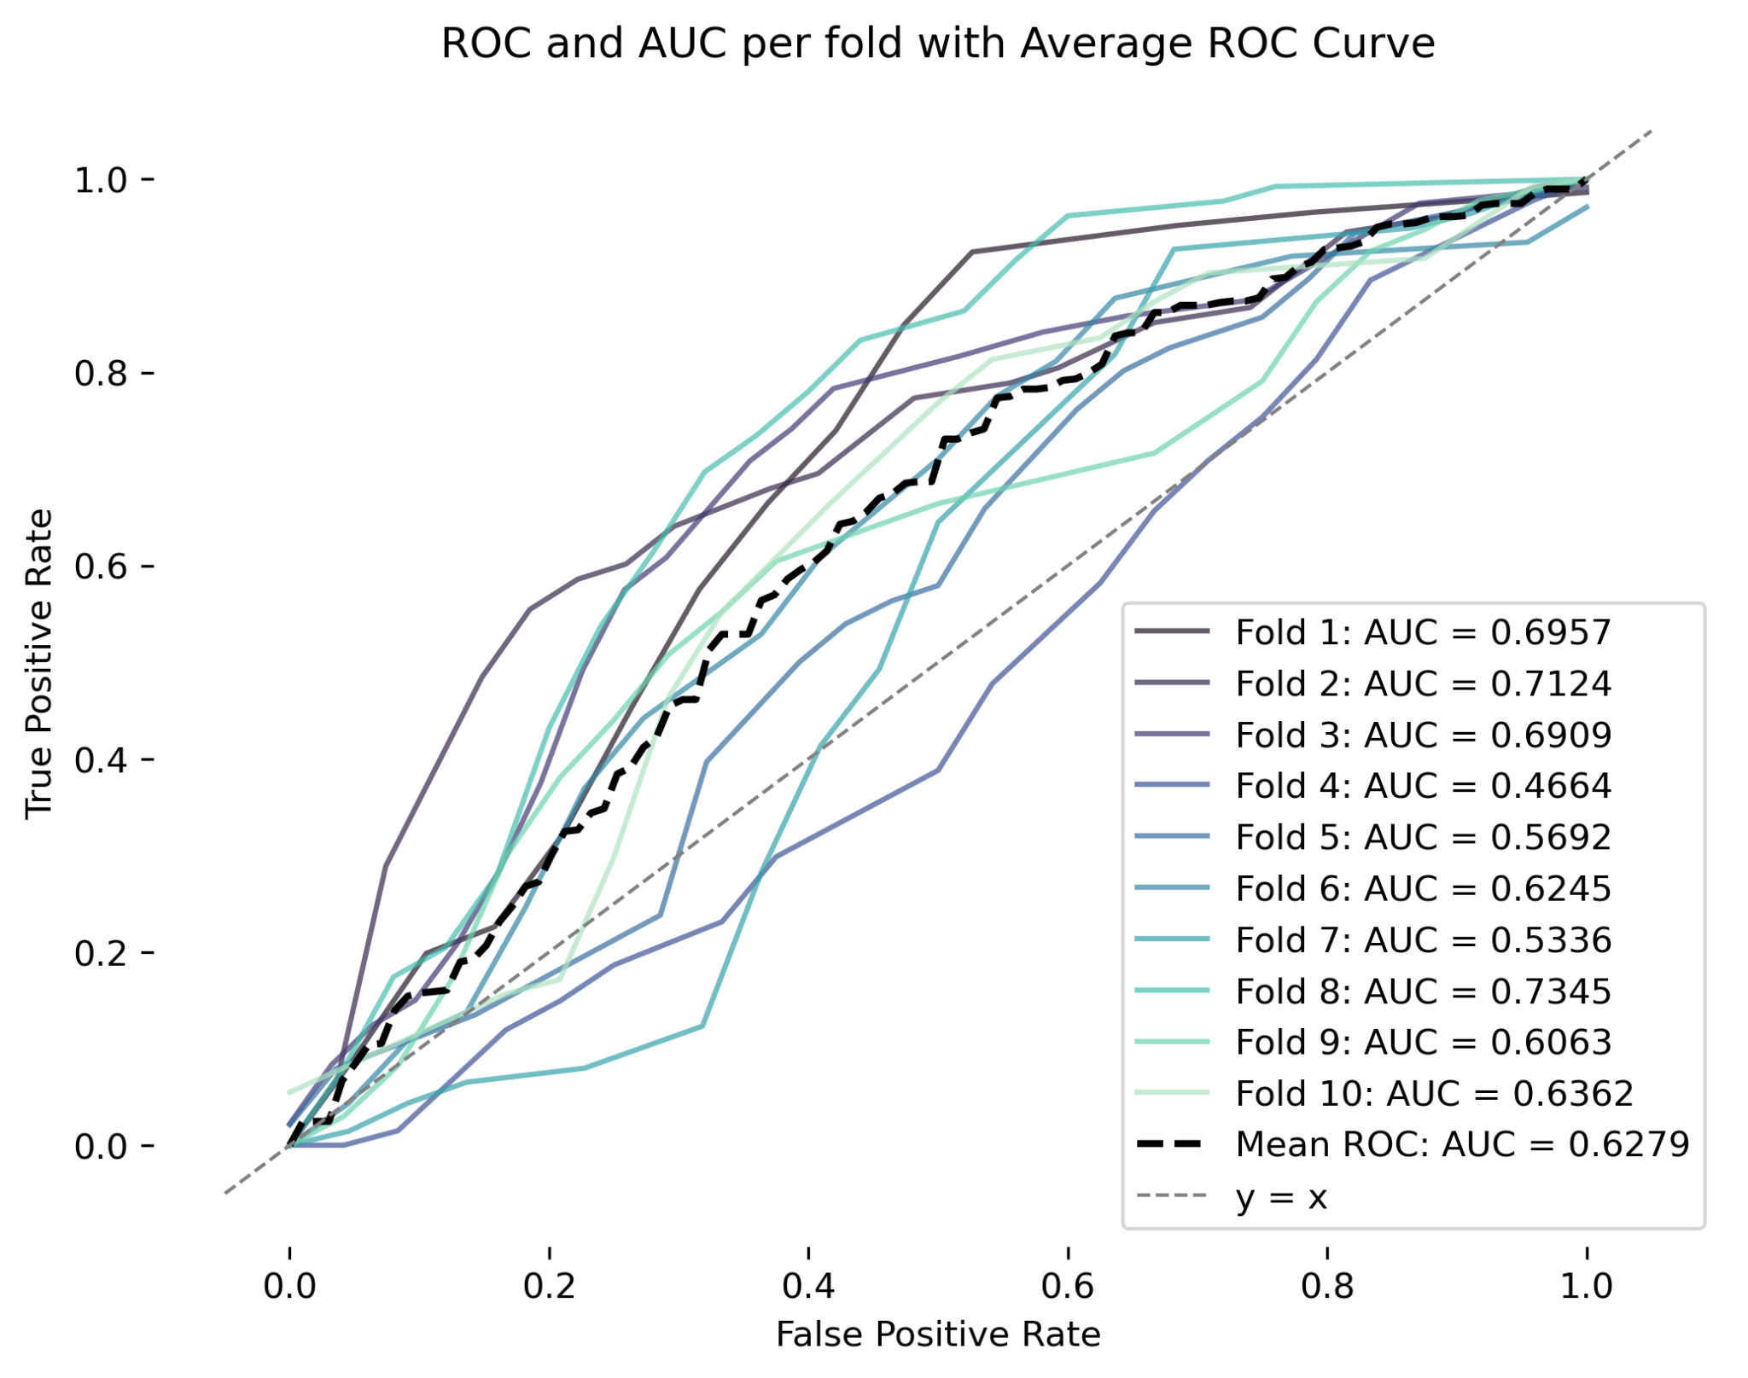
Trial 3: 2008 vs. 2020
changed the order of the slides (I think telling the story by focusing first on trial 4 makes more sense). to makae sense to the viewer trial 3 in presentation corresponds to trial 4 in images in github
can you substitute the left hand side image by this? don’t know how to edit images in powerpoint online (loyal to powerpoint app ahahah)

Slide 22
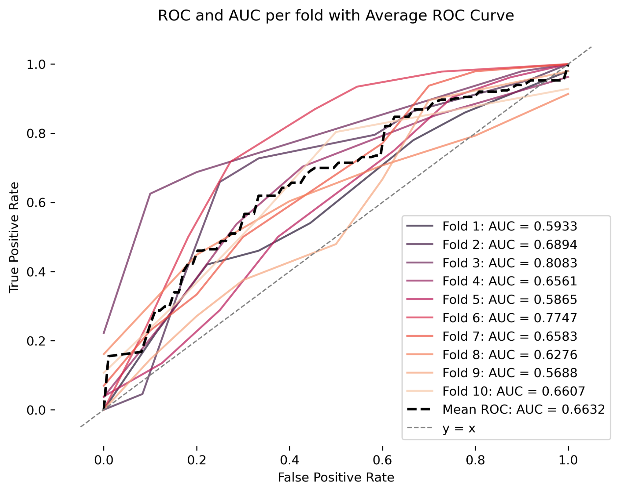
Trial 4: 2008 vs. 2020

